Slide 1




National Rural Employment Guarantee Act Analysis Using Power Bi
Presented By : Ms. Manya Bajaj

Slide 2
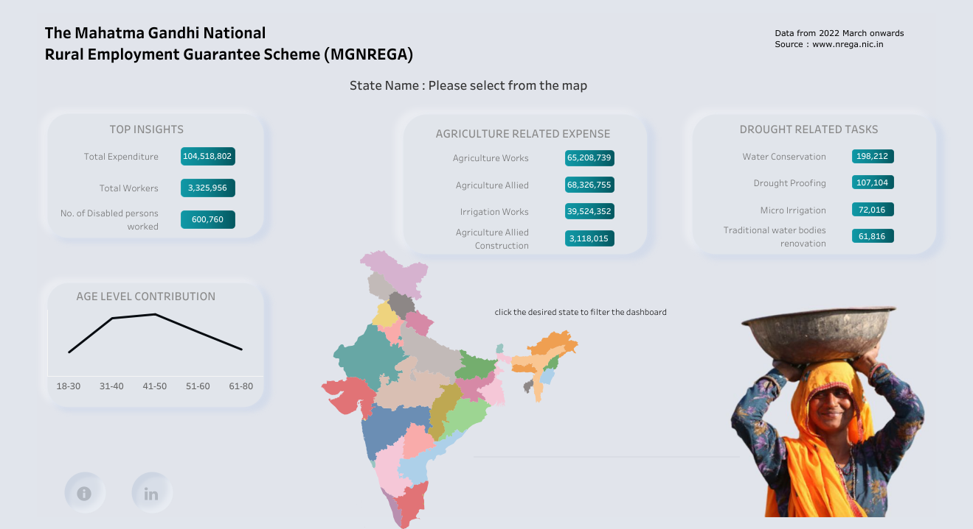
Introduction
The Mahatma Gandhi National Rural Employment Guarantee Act (NREGA) is a critical initiative aimed at addressing rural unemployment and poverty in India. This project seeks to analyze a comprehensive dataset related to NREGA using Power BI to gain insights into its effectiveness and implementation. By examining data on employment opportunities, regional disparities, budget utilization, and factors influencing the completion of NREGA works, we aim to provide valuable information that can guide policymakers and administrators in optimizing the scheme's impact and ensuring that it effectively alleviates rural unemployment and poverty.

Slide 3
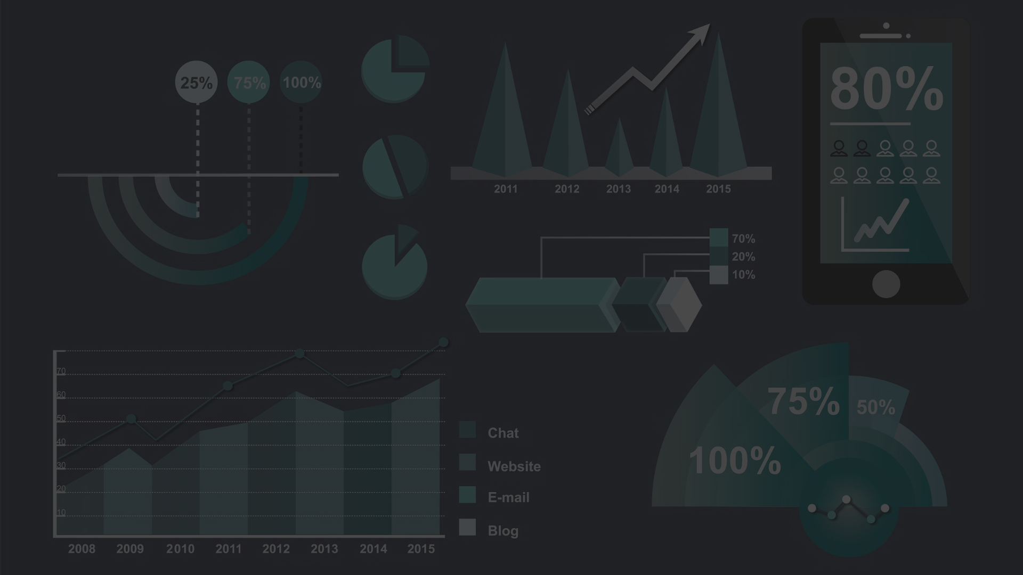
Aim and Objective
1
Aim
2
Objectives
1. Utilize Power Bi and data analysis to derive insights from the NREGA dataset.
1. Assess NREGA's effectiveness in providing rural employment.
2. Analyze budget utilization and employment correlation.
3. Identify key factors and roadblocks in project completion.

Slide 4
Data Preparation
1
Data Sources:
2
Data Cleaning:
- Gather data from the provided csv file by Mentorness
- Use Power Query in Power BI to clean and transform the data.
- Ensure data is clean, well-formatted, and integrated into a unified dataset.
- Handle missing values, remove duplicates, and format columns as needed.

Slide 5
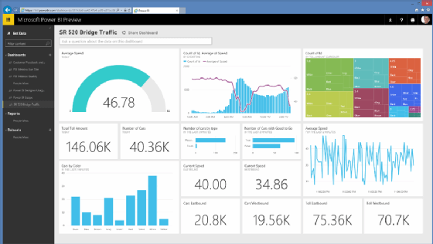
Loading Data into Power BI
1
Open Power BI Desktop
Launch the Power BI Desktop application on your computer.
2
Import Data
Click on "Get Data" and choose your data source (Excel, CSV, SQL Server, etc.).
3
Load Data
Load the imported data into Power BI by clicking "Close & Apply."

Slide 6

Visualizations Using
POWER BI

Slide 7

How effective is NREGA in providing employment
opportunities to rural households?

Slide 8
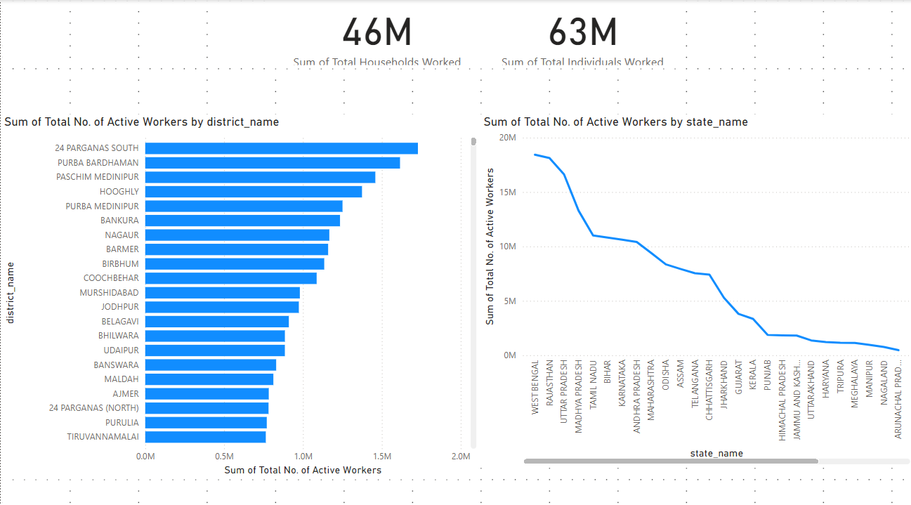

Slide 9
Are there regional disparities in the
implementation and outcomes of the scheme?

Slide 10
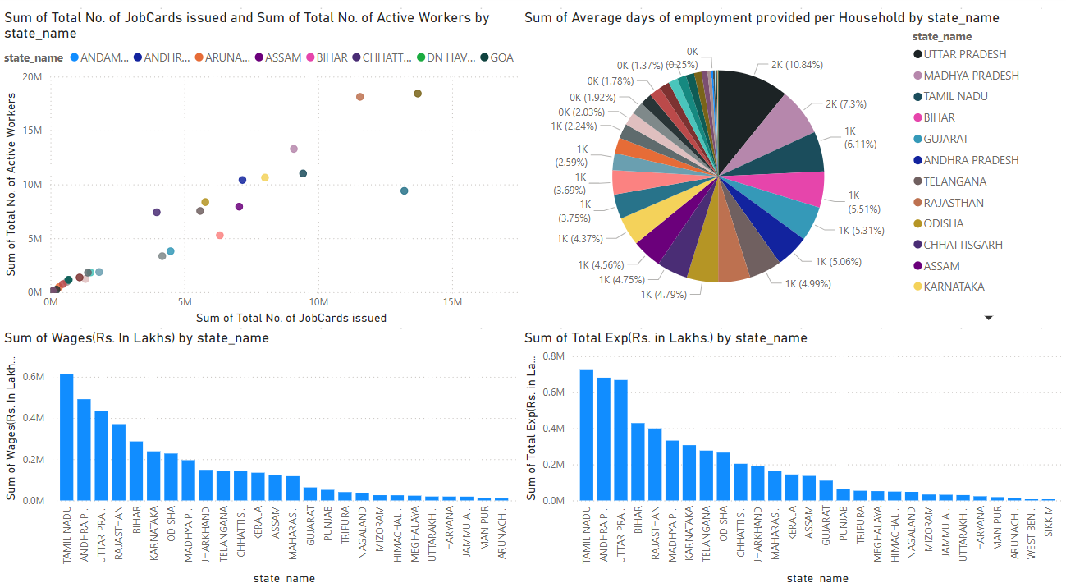

Slide 11
What is the utilization of the
Allocated budget, and how does it correlate with
employment generation?

Slide 12
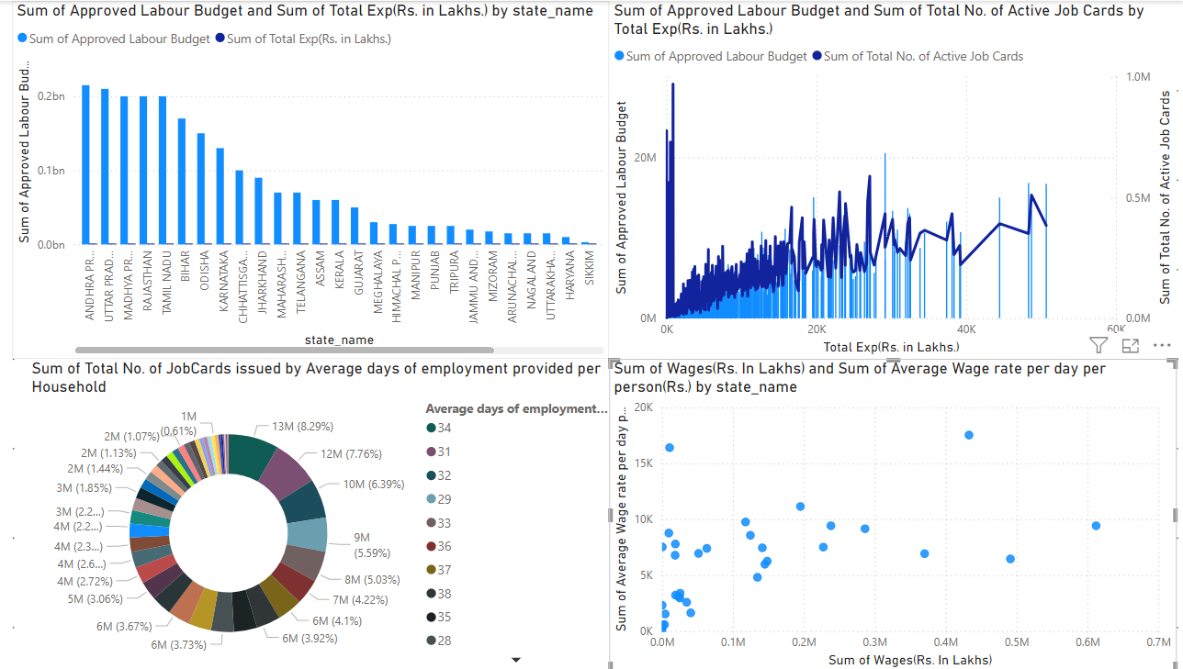

Slide 13
What are the key factors contributing
to the completion of NREGA works, and are there
any roadblocks to its success?

Slide 14
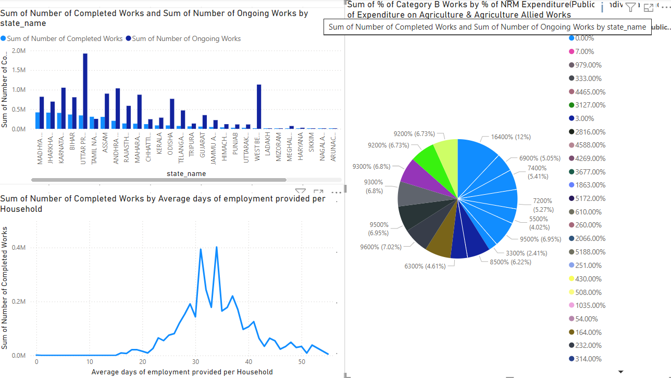

Slide 15
Can data-driven insights guide
policymakers and administrators in optimizing the
scheme's impact?

Slide 16
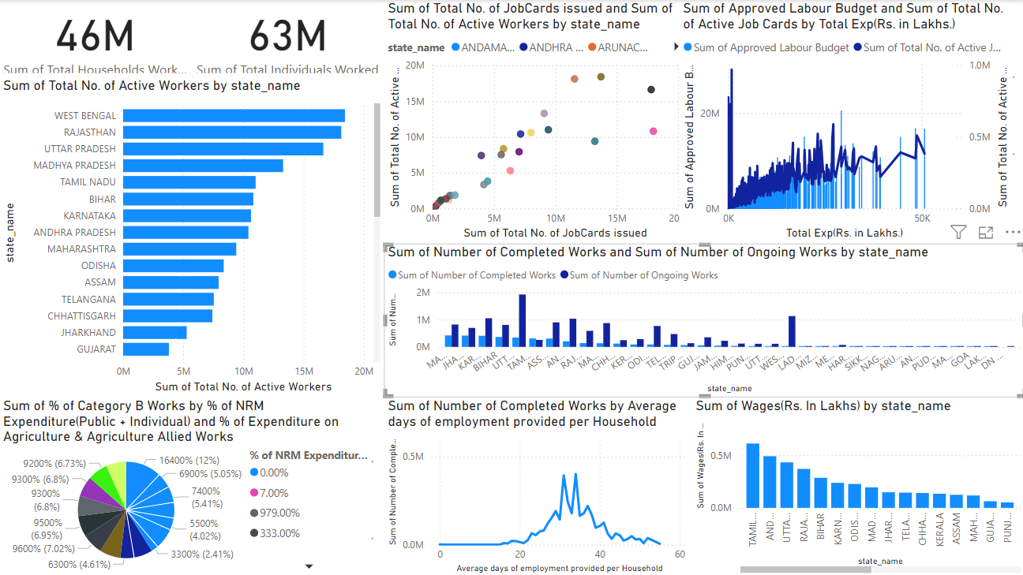

Slide 17
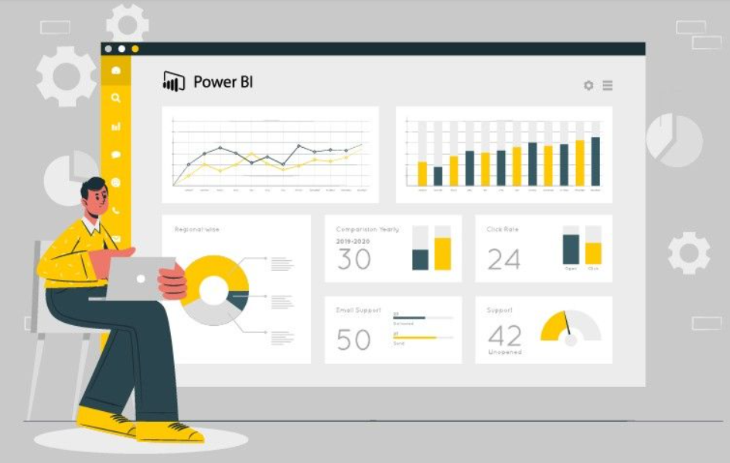

Conclusion
Key Insights
Data-Driven Approach
The analysis revealed a significant disparity in NREGA job demand across different regions, highlighting the need for targeted resource allocation and program implementation strategies.
The project uses Power BI for a data-driven analysis of NREGA, focusing on data collection, cleansing, analysis, and visualization to optimize program outcomes.

Slide 18



